Slide 2
The Three Branches of Government
Peterastn, “tree in front of the sun” December 18, 2005 via flickr, Creative Commons Attribute

Slide 3
What Are The Three Branches
Legislative Branch
Executive Branch
Judicial Branch

Slide 4
Separation of Powers
Each branch is responsible for their job
No one gets too much power
Helps thing run smoothly

Slide 5
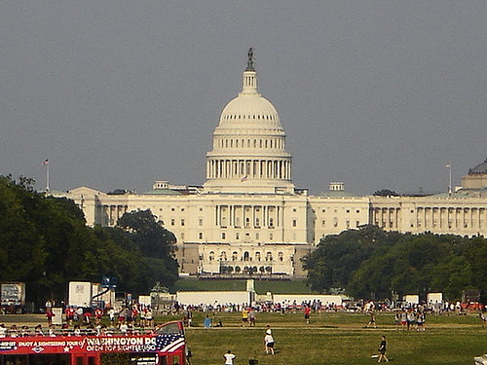
Legislative Branch
Article I of the Constitution
Has power to make laws
Sets apart funds for government
Scubadive67, “Capital Building” September 7, 2007 via Flickr, Creative Commons Attribute

Slide 6
Who is in the Legislative Branch?
Congress
Congress is made up of two parts
The Senate
The House of Representatives

Slide 7
The Senate
The Senate has 100 members
Two from each state
Must be at least 30 years old

Slide 8
The Senate
Must live in the state he/she represents
Elected for 6 years
Must be a citizen for 9 years

Slide 9
House of Representatives
Has 435 members
At least 1 representatives from each state
Elected by the people

Slide 10
House of Representatives
2-year term
At least 25 years old
Must be a citizen for 7 years

Slide 11
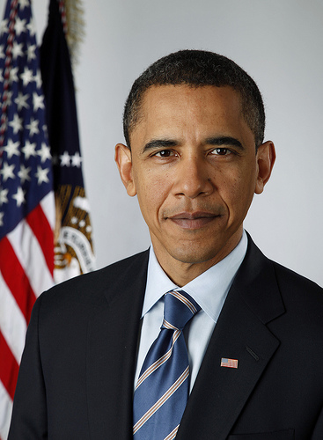
Executive Branch
Article II, Section I of the Constitution
Makes sure laws are obeyed
The President is the head
Ethan Bloch, “Barack Obama” January 14, 2009 via flickr, Creative Commons Attribute

Slide 12
The President Gets Help From…
Vice President
Departments heads/cabinet members
Independent Agencies

Slide 13
Judicial Branch
The countries court system
Decides meaning of laws
Decides how laws are applied
Decides if the laws break the rules

Slide 14
The Supreme Court
Highest court in the U.S.
Made up of 9 judges/justices
There is one Chief Justice

Slide 15
The Supreme Court
Appointed by the President
Approved by the Senate
Justices have their job for life

Slide 16
Checks and Balances
The branches check each others power
Set to maintain balance of powers

Slide 17
Can appoint or reject judicial nominations
Can Declare acts of the executive unconstitutional
Can declare laws unconstitutional
Nominates Federal Judges
Can override executive’s veto and reject judicial nominations
Can veto laws made by the legislative

Slide 18
Conclusion
The founding fathers and the framers of the Constitution set the three branches in place in order to create a balance of power. The three branches work together to assure the rights of citizens are not overlooked.

