Slide 1
The Constitution Says What?!
Chapter 5.3 Vocabulary – Quiz on Friday!

Slide 2
Word!
Union - a political unit consisting of a number of states or provinces with the same central government
Amendment - a minor change that improves or corrects a document.
Domestic – existing or happening inside a particular country; not foreign or international.
Concurrent - existing, happening, or done at the same time
Power – the ability to do things that influence or control the behaviors of others.

Slide 3
Wowza!
Reserved – kept specially for a particular purpose or person
Reserved Powers – you tell me!
Check – restrain
Balance – a condition in which different elements are equal or in the correct proportions
Checks and Balances – a system that balances the influences and powers of different parts of an organization

Slide 4
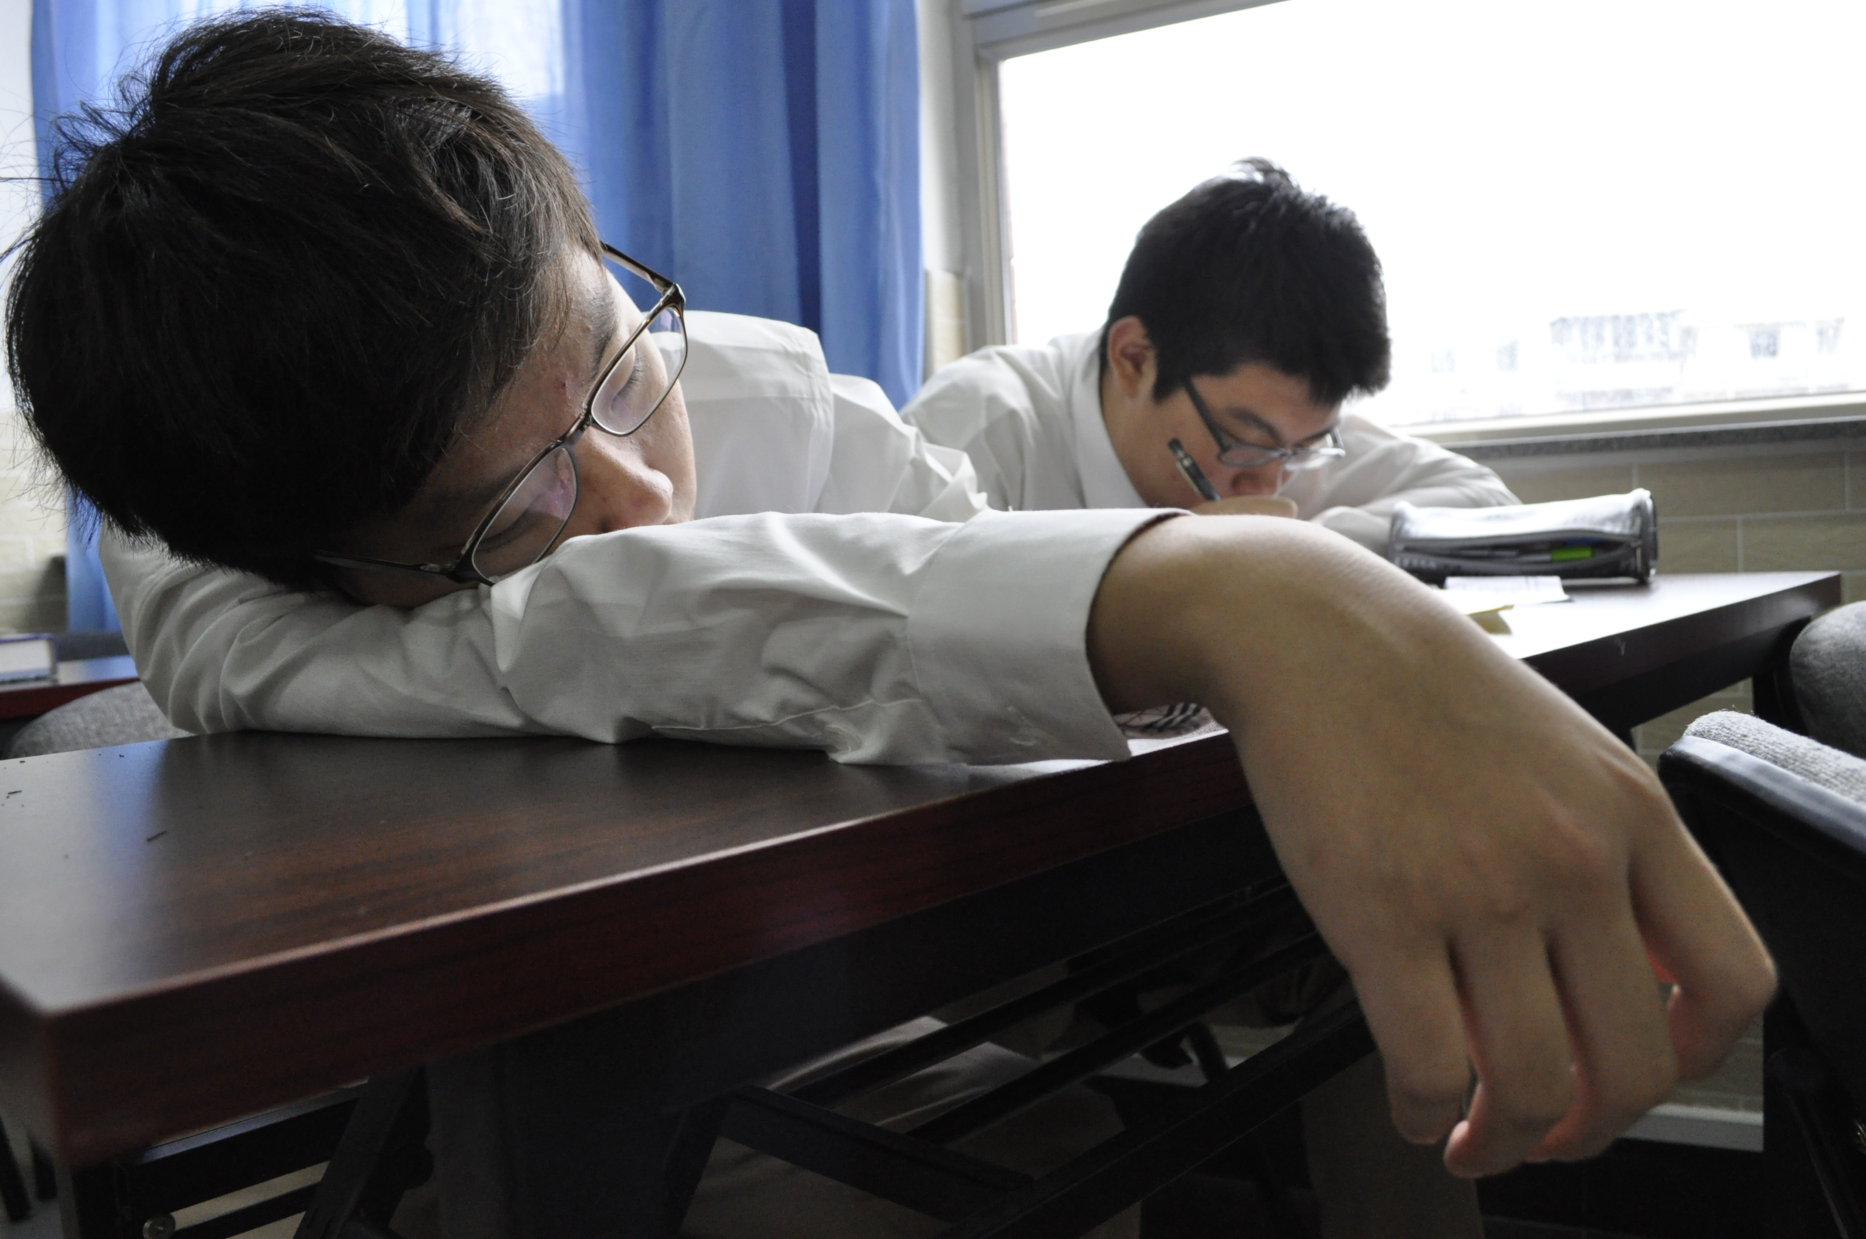
Don’t be like this guy!

Slide 5
Who likes peanut butter?
Impeach – to accuse someone of doing something bad
Article - a separate rule or paragraph of a legal document (i.e. The Constitution).
Preamble – the first statements of a document
Welfare - the health, happiness, and fortunes of a person or group
Blessings - a beneficial thing for which one is grateful

Slide 6
Can I get a “Shenma! Shenma!?”
Tranquility - free from disturbance; calm
Common Defense – protection for everyone in a certain country
Legislature – the branch of the government that makes laws (Representatives and Senators)
Executive - the branch of the government that enforces the laws (President)
Judicial - the branch of the government that decides if actions and laws are okay according to the constitution.

Slide 7
If you’re still awake, I’m impressed.
Approval – an agreement that something is okay
Elastic - flexible and adaptable

